Slide 1

AKS Office Hours
Kendall Roden
Cloud Native Technical Specialist
Kendal Roden
Cloud Native Technical Specialist
Dave Strebel
Cloud Native Technical Specialist

Slide 2

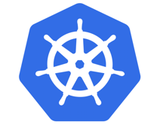


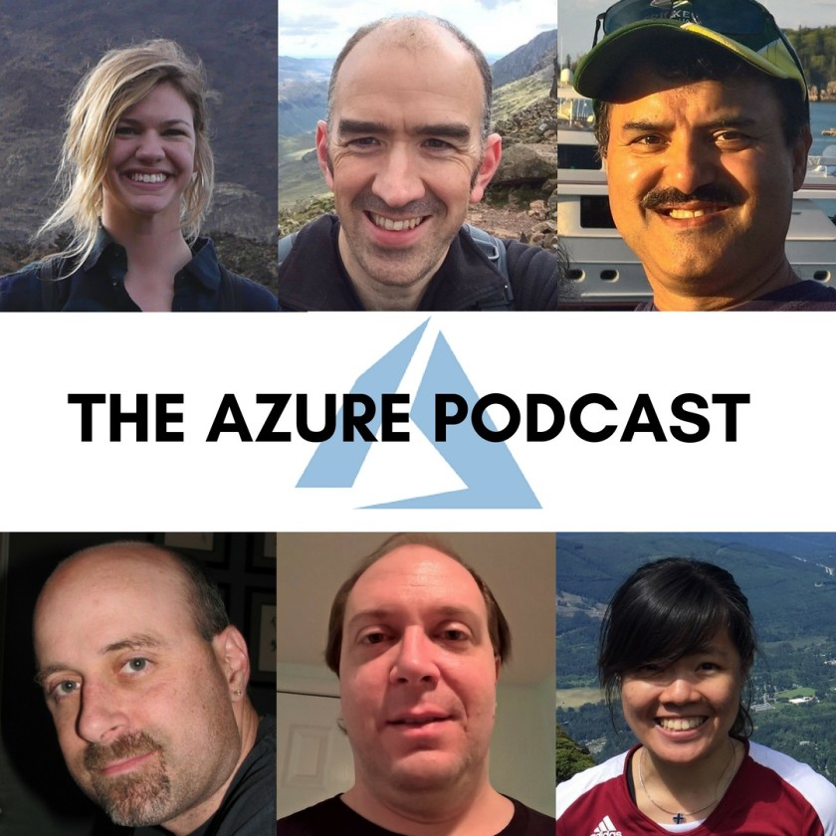

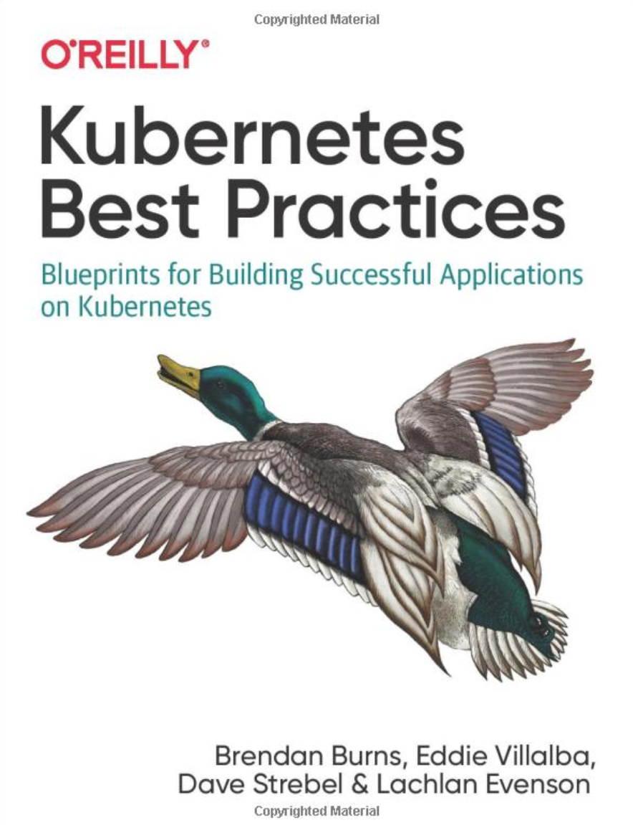
Who are we?
@kendallroden​
@dave_strebel​

Slide 3
Why AKS Office Hours?
Provide AKS customers with updates pertaining to AKS and the Cloud Native Ecosystem
Host a short talk and/or demo on Cloud Native technologies related to Kubernetes and AKS
Collect feedback from customers on issues, blockers, use cases, and questions related to AKS

Slide 4
What to expect
Call agenda
5-10 minutes: Welcome, followed by AKS and ecosystem updates
30-40 minutes: KEDA with Kendall Roden – Cloud Native Technical Specialist
10-15 minutes: “Ask us anything” and customer feedback discussion
Keep in mind
We want two-way interaction, but please stay on mute when you are not speaking
Office hours are hosted primarily by the GBB team, with the support of the PG
Recordings and content will be available post-call, barring any technical difficulties
Contact us with thoughts, ideas or questions (aksofficehours@microsoft.com)

Slide 5

AKS Updates

Slide 6
AKS Updates
GA
Creation of clusters and nodepools with containerd, enhancing pod creation speed and stability (default)
maxSurge
Support for Kubernetes 1.19 release
Ephemeral OS disk for AKS Agent Nodes
AKS image now aligns to Microsoft Security Baseline that conforms to Linux and K8s benchmarks for CIS hardened images

Slide 7
Ecosystem Updates

Slide 8
Ecosystem Updates
Anyone have thoughts on KubeCon 2020?
Anyone attend Open Azure Day yesterday?
Kubernetes Security Specialist Cert is GA (11/17)

Slide 9

Presented by Kendall Roden
Content curated from https://keda.sh/docs/2.0

Slide 10
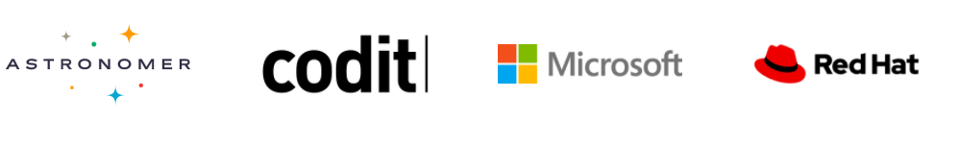
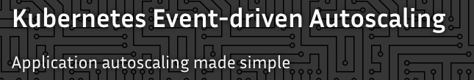

KEDA Kubernetes Event-driven Autoscaling
Sandbox project
Reference: https://keda.sh/
Notes:
KEDA is a single-purpose and lightweight component that can be added into any Kubernetes cluster. KEDA works alongside standard Kubernetes components like the Horizontal Pod Autoscaler and can extend functionality without overwriting or duplication. With KEDA you can explicitly map the apps you want to use event-driven scale, with other apps continuing to function. This makes KEDA a flexible and safe option to run alongside any number of any other Kubernetes applications or frameworks.
Original developed by Microsoft and RedHat then donated to CNCF in April 2020

Slide 11






KEDA Features
Event-Driven
Intelligently scale your event-driven application
Simple autoscaling
Bring rich scaling to every container in your Kubernetes cluster
Built-in Scalers
Out-of-the-box scalers for various vendors, databases, messaging systems, telemetry systems, and more
Multiple Workload Types
Support for variety of workload types such as deployments and jobs
Vendor- Agnostic
Support for triggers across multiple vendors
Azure Functions Support
Run and scale your Azure Functions on Kubernetes in production workloads
Reference: https://keda.sh/

Slide 12
Horizontal Pod Autoscaler
The horizontal pod autoscaler (HPA) uses the Metrics Server in a Kubernetes cluster to monitor the resource demand of pods. If a service needs more resources, the number of pods is automatically increased to meet the demand.
͏HPA obtains resource metrics and compares them to user-specified threshold
2
Node1
Horizontal Pod Autoscaler
Pod
3
Deployment
ReplicaSet
͏HPA evaluates whether user specified threshold is met or not
replicas++
Kubelet
replicas--
4
cAdvisor
Pod
͏HPA increases/decreases the replicas based on the specified threshold
Grabs metrics
1
NodeX
͏The Deployment controller adjusts the deployment based on increase/decrease in replicas
Metrics Server
Node2
Pod
Collects metrics from all containers on the node
Kubelet
Collects metrics from all nodes
cAdvisor

Slide 13
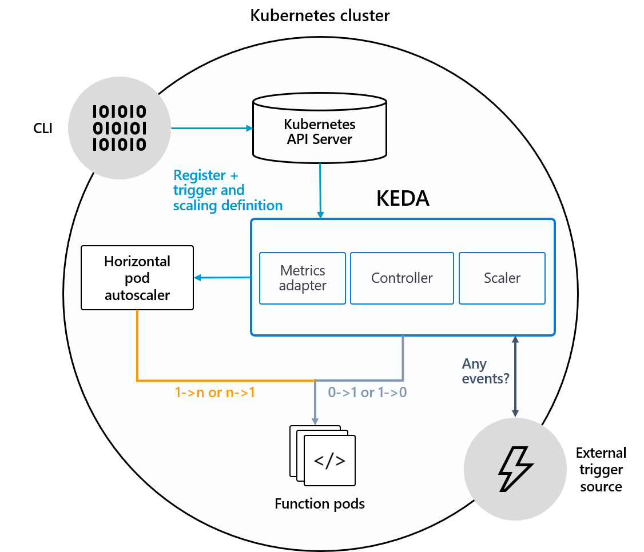
How KEDA works
1. Agent
KEDA activates and deactivates Kubernetes Deployments to scale to and from zero on no events (utilizes the keda-operator)
2. Metrics
KEDA acts as a Kubernetes metric server that exposes rich event data to the HPA to drive scale out. The deployment consumes the events directly from the source (utilizes the keda-operator-metrics-apiserver)
Reference: https://keda.sh/docs/2.0/concepts/#architecture

Slide 14
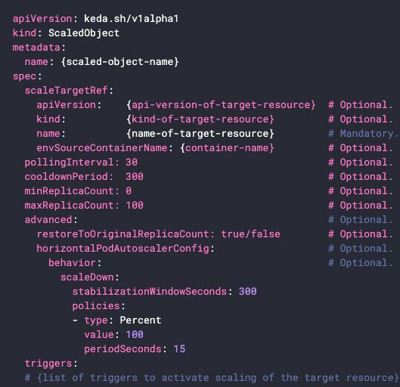
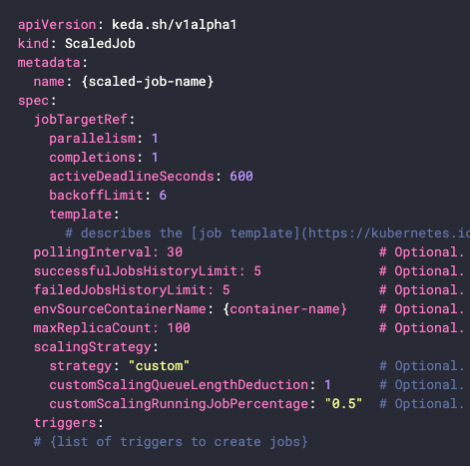
KEDA Custom Resources (CRD)
ScaledObjects (scaledobjects.keda.sh)
ScaledJobs (scaledjobs.keda.sh)
The desired mapping between an event source (e.g. Rabbit MQ) and the Kuberentes Deployment, StatefulSet, or any Custom Resources that defines /scale subresource
The mapping between event source and Kubernetes Job
Reference: https://keda.sh/docs/2.0/concepts/

Slide 15
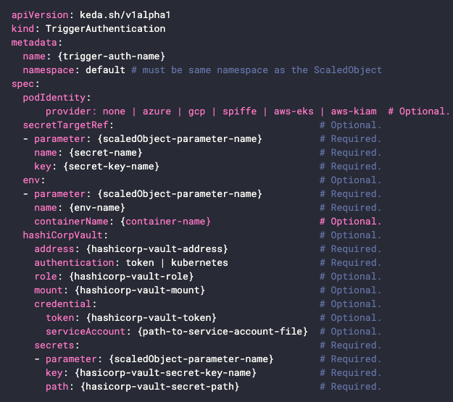
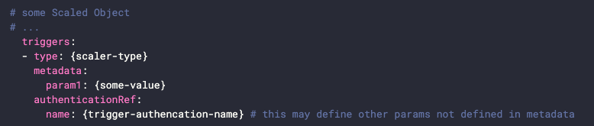
KEDA Custom Resources (CRD)
triggerauthentications.keda.sh
ScaledObject/ ScaledJob may also contain a TriggerAuthentication which contains authentication configuration or secrets to monitor the event source
Reference: https://keda.sh/docs/2.0/concepts/authentication/

Slide 16
Demo

Slide 17
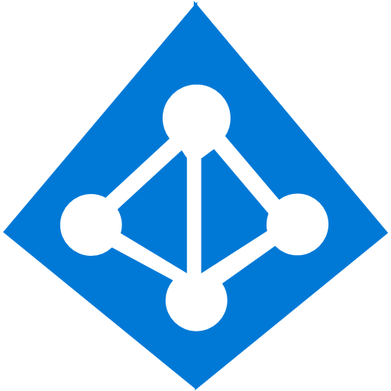
Pod identity
Developer
Kubernetes operator defines an identity map for K8s service accounts
<\>
Node Managed Identity (NMI) watches for mapping reaction and syncs to Managed Service Identity (MSI)
3
Kubernetes
Kubernetes controller
Azure Identity Binding
Azure SQL Server
Developer creates a pod with a service account, and pod uses standard Azure SDK to fetch a token bound to MSI
1
Pod
Pod uses access token to consume other Azure services; services validate token
Active Directory Pod Identity
Token
Azure MSI
4
NMI + EMSI
2

Slide 18
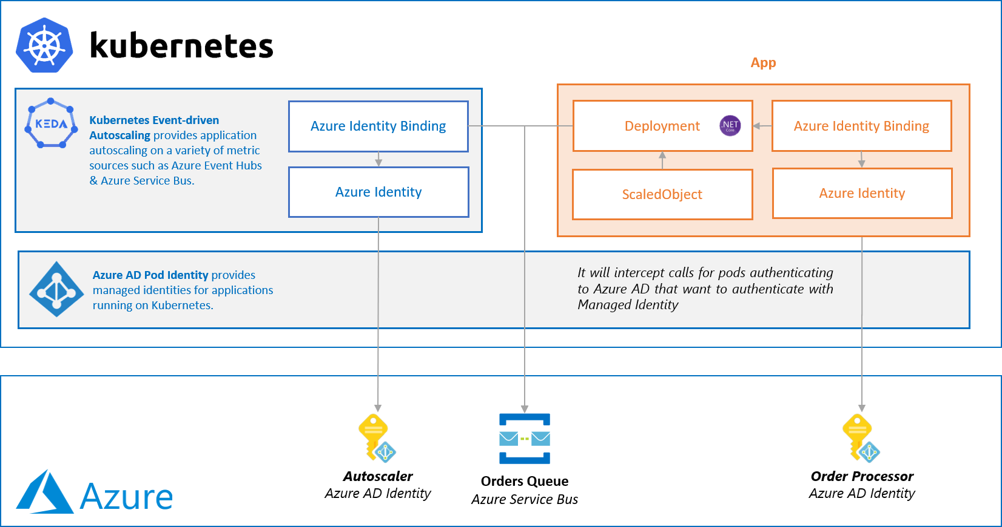
KEDA + Azure AD Pod Identity
Reference: https://github.com/kedacore/sample-dotnet-worker-servicebus-queue/
Notes:
Azure Pod Identity
Azure Pod Identity is an implementation of Azure AD Pod Identity which let’s you bind an Azure Managed Identity to a Pod in a Kubernetes cluster as delegated access - Don’t manage secrets, let Azure AD do the hard work.
You can tell KEDA to use Azure AD Pod Identity via podIdentity.provider.
podIdentity: provider: azure # Optional. Default: false
Azure AD Pod Identity will give access to containers with a defined label for aadpodidbinding. You can set this label on the KEDA operator deployment. This can be done for you during deployment with Helm with --set podIdentity.activeDirectory.identity={your-label-name}.

Slide 19
Why use KEDA if you are using Azure Functions?
Run functions on-premises (potentially in something like an ‘intelligent edge’ architecture)
Run functions alongside other Kubernetes apps (maybe in a restricted network, app mesh, custom environment, etc.)
Run functions outside of Azure (no vendor lock-in)
Specific need for more control (GPU enabled compute clusters, policies, etc.)
Reference: https://keda.sh/docs/2.0/faq/

Slide 20
Let’s review! Kubernetes-based event-driven auto-scaling (KEDA)
Open-source component jointly built by Microsoft and RedHat
Event-driven container creation & scaling Allows containers to “scale to zero” until an event comes in
​Native triggers support Containers can consume events directly from the event source, instead of routing events through HTTP
​Can be used in any Kubernetes service This includes in the cloud (e.g., AKS, EKS, GKE, etc.) or on-premises with OpenShift
Kubernetes cluster
Scaler
AKS cluster
External trigger source
Controller
Metrics adapter
KEDA

Slide 21
Getting Involved
Attend KEDA Community Meetings Bi-weekly Tues 16:00 UTC (Subscribe to Google Agenda | Convert to your timezone)
Join the #KEDA channel on Kubernetes Slack
Reference: https://keda.sh/docs/2.0/faq/
Notes:
Zoom link: https://us02web.zoom.us/j/150360492?pwd=eUVtQzBPMzFoQUR2K1dqUWhENjJJdz09 (Password: keda)
Meeting agenda: https://hackmd.io/s/r127ErYiN

Slide 22
Thank you!

